Slide 1

Junior students’ presentation (12/18)
Student : 黃彥鈞 Weberstein YC, Huang (m946108006)
Director : Yung-Chun, Chang；Min-Huei, Hsu
Lab : TMU NLP

Slide 2
Content
Past
2019-10-15
Present
2019-12-31
Future
JOINT NLP LAB
Competition
2019 AI新銳領航者競賽
AI CUP 2019
NTCIR-15
Medical text Embedding, Cross-lingual Embedding, Reinforcement Learning
Paper Review
Paper Work
Advanced Text Embedding in Sentiment Analysis?

Slide 3
Competition
2019 AI 新銳領航者競賽
AI CUP 2019
NTCIR-15

Slide 4


2019 AI 新銳領航者競賽 – 長榮航空組 (1/2)
影響航空公司成本的原因很多，其中以燃油成本佔比最高，而燃油成本上升的 因素則包括班機總重、飛行時長……等。請透過探索性資料分析報告找出相關因素，在飛行安全無虞及精緻服務品質的前提下，給予合適的建議以有效地控管該成本。
There are many factors that affect flight costs, among which fuel costs account for the highest proportion, and factors that increase fuel costs include the total weight of flights, flight duration, etc. Given the ease and degradation of refined service quality, give appropriate advice to effectively control the cost.

Slide 5
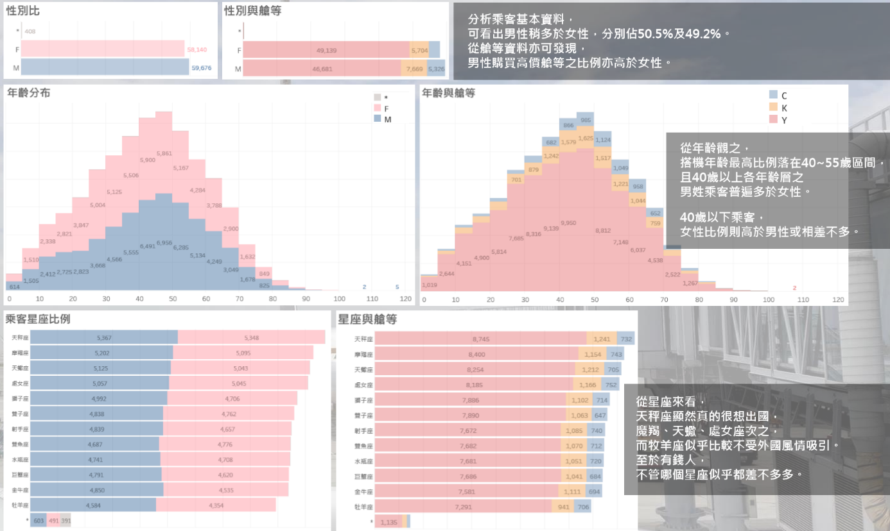
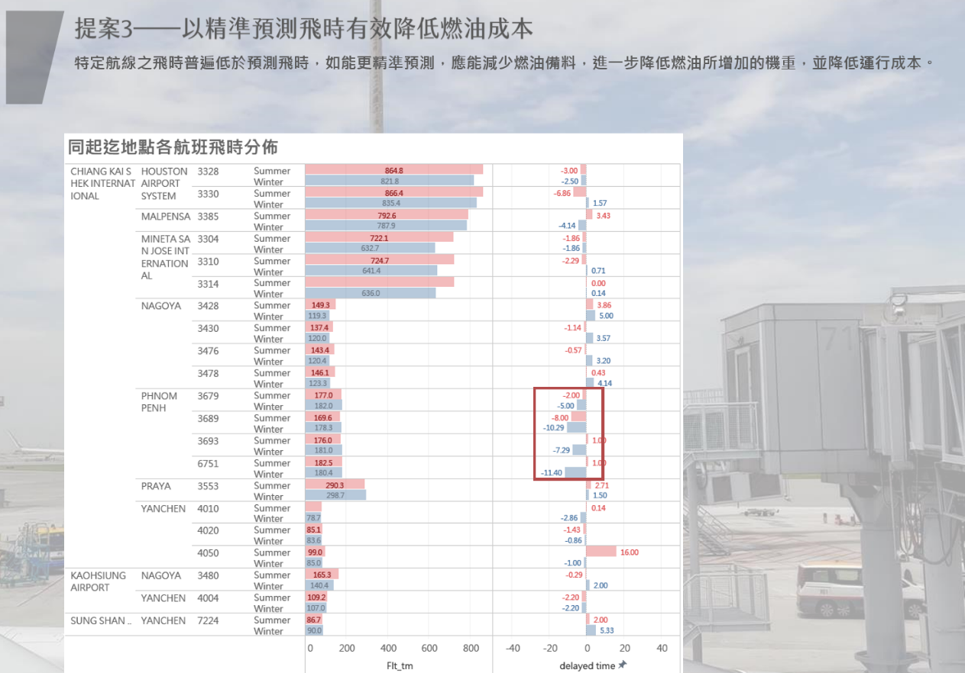
2019 AI 新銳領航者競賽 – 長榮航空組

Slide 6
AI CUP 2019 (1/2)
教育部全國大專校院人工智慧競賽(AI CUP 2019)-人工智慧論文機器閱讀競賽之論文分類
從arXiv的電腦科學相關論文摘要，預測出摘要所屬的類別(Theoretical Paper, Engineering Paper, Empirical Paper, Others)。需注意的是摘要可以有多個分類，例如: 摘要可以同時是Theoretical Paper和Engineering Paper。
From the abstract of arXiv computer science related paper, predicting the categories to which the abstract belongs (Theoretical Paper, Engineering Paper, Empirical Paper, Others). It should be noted that the abstract can have multiple categories, for example: The abstract can be both Theoretical Paper and Engineering Paper.

Slide 7
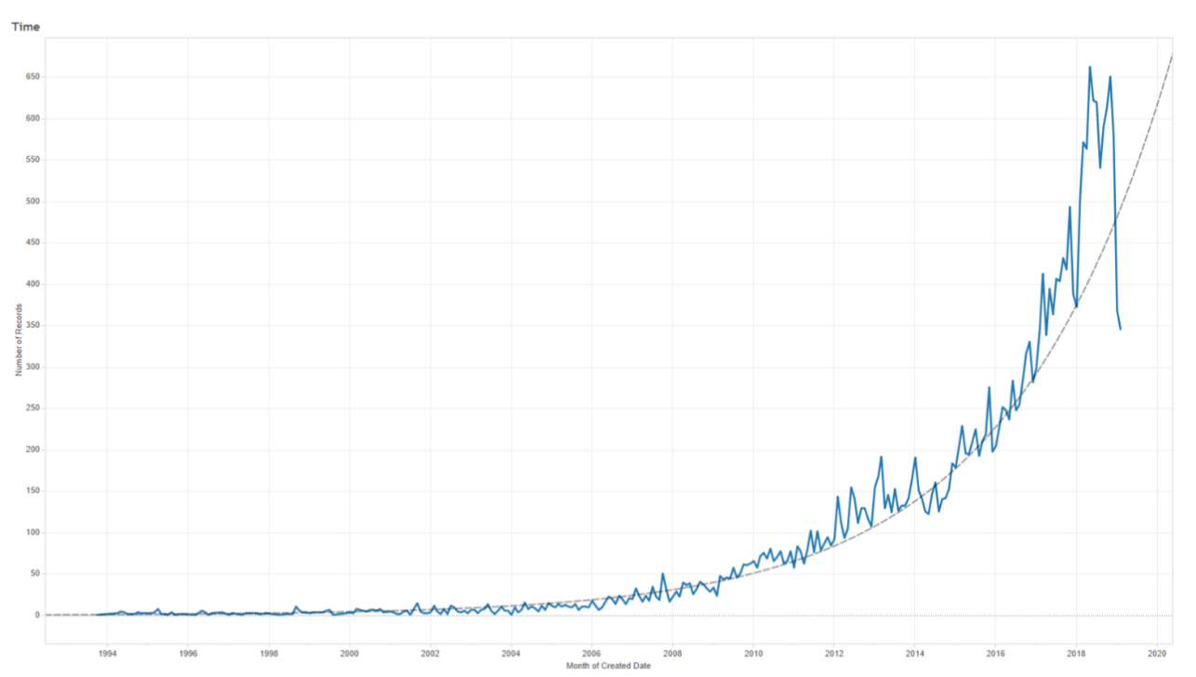
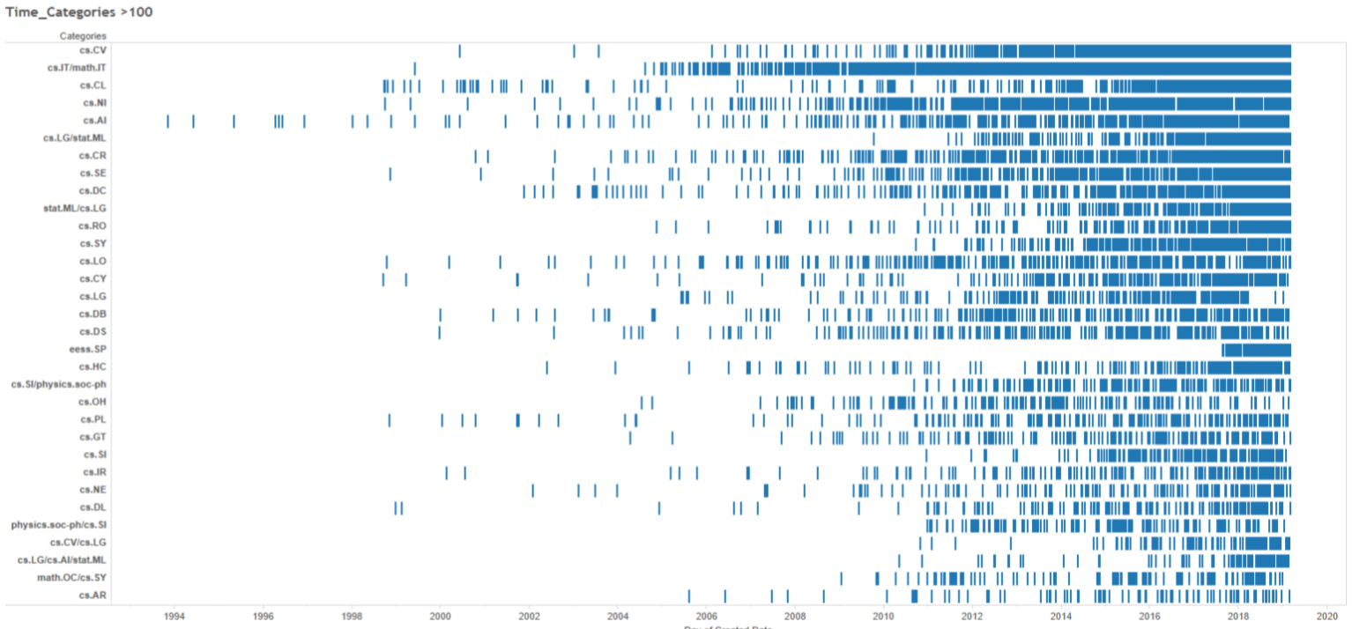
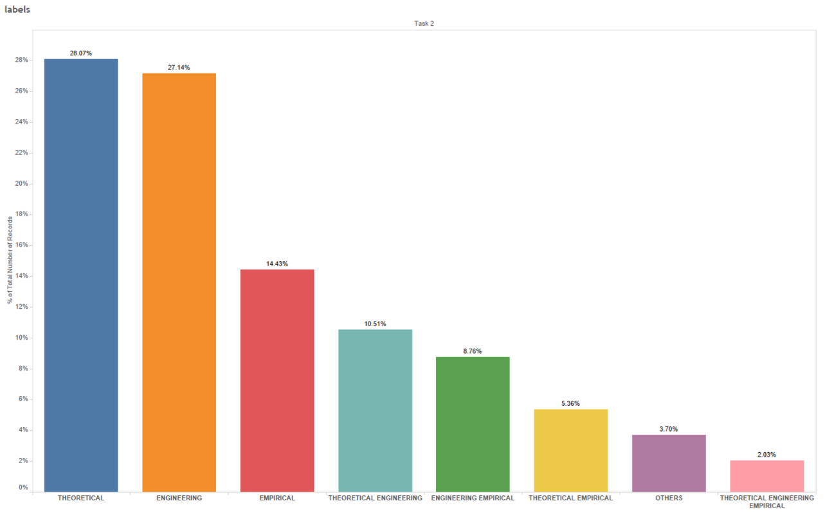
AI CUP 2019 (1/3) (2/3)

Slide 8
NTCIR-15

Slide 9
Paper Review
Medical text Embedding
Cross-lingual Embedding
Reinforcement Learning

Slide 12
Paper Work
Advanced Text Embedding in Sentiment Analysis?

Slide 14
Title and Content Layout with Chart

Slide 15
Two Content Layout with Table
First bullet point here
Second bullet point here
Third bullet point here
Class | Group 1 | Group 2
Class 1 | 82 | 95
Class 2 | 76 | 88
Class 3 | 84 | 90

Slide 16
Title and Content Layout with SmartArt
Step 1 Title
Task description
Task description
Task description
Task description
Step 2 Title
Task description
Task description
Task description
Step 3 Title
Task description
Task description
Step 4 Title
Task description
Task description

Slide 17
Add a Slide Title - 2

Slide 18
Add a Slide Title - 3

Slide 20
Add a Slide Title - 4

Slide 21
Add a Slide Title - 5

